Slide 1
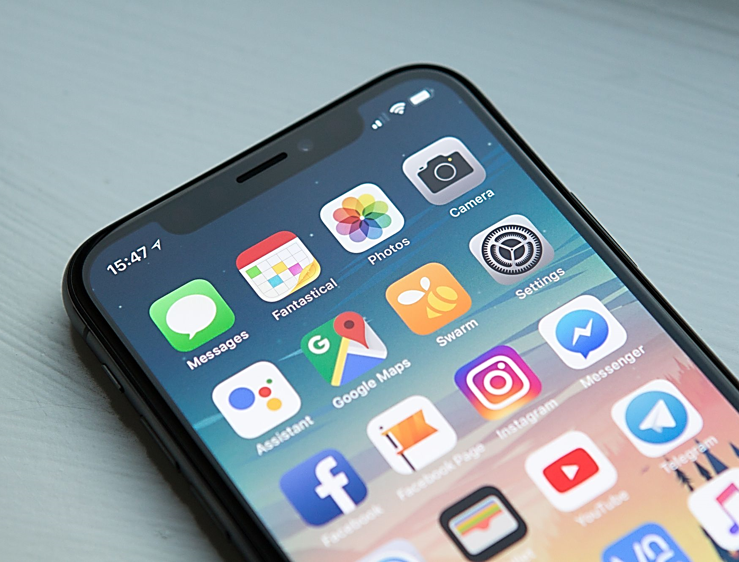


Mobile Apps Programming
P E D Putra, M.Si.
Lecture 6 – Text input, Scroll view dan List view using kivymd

Slide 2

Using MDTextField
The MDTextField widget in KivyMD is used for text input
Basic Properties:
`hint_text`
Text to display as a hint or placeholder in the text field
`input_type`
Type of input (e.g., "text", "number", "email")
`helper_text`
Additional text to display below the text field
`mode`
Specifies the appearance of the text field. It can be "rectangle" or "fill".

Slide 3
Using MDTextField
self.root.ids.text_field.text is used to retrieve the text entered by the user in the MDTextField widget
In Kivy, self.root refers to the root widget of the application.
retrieves the reference to the MDTextField widget
The ids attribute is a dictionary that holds references to all widgets with an id property within the current widget tree
def on_submit(self):
text_input = self.root.ids.text_field.text
print("Text submitted:", text_input)

Slide 4
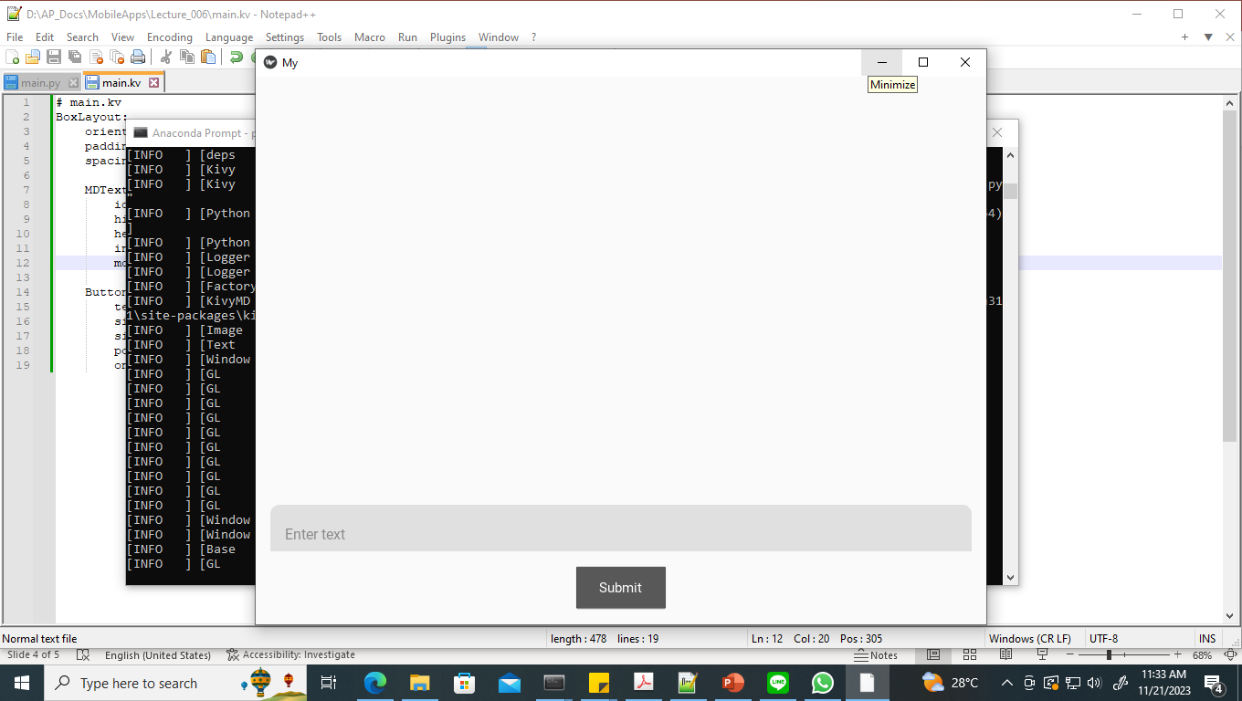
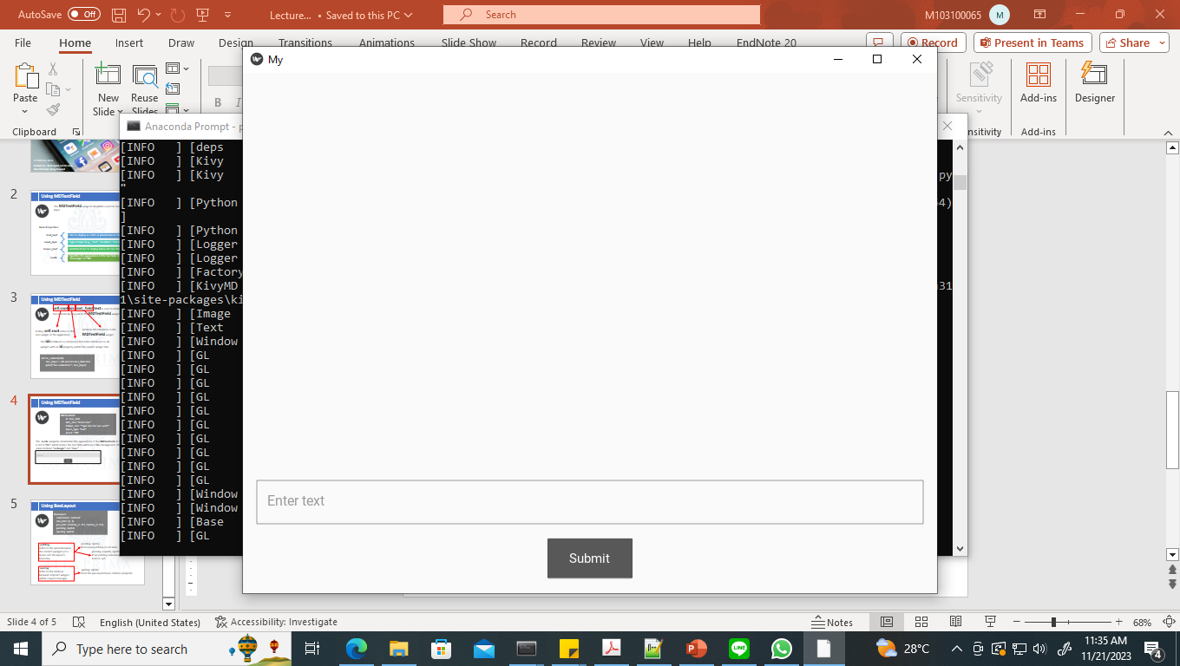
Using MDTextField
MDTextField:
id: text_field
hint_text: "Enter text"
helper_text: "Type any text you want"
input_type: "text"
mode: "fill"
The `mode` property determines the appearance of the MDTextField. In this example, it is set to "fill" which means the text field will have a filled background. Other possible values include "rectangle" and "line."
"fill"
“rectangle"

Slide 5
Using BoxLayout
BoxLayout:
orientation: 'vertical'
size_hint: (1, 1)
pos_hint: {'center_x': 0.5, 'center_y': 0.5}
padding: dp(16)
spacing: dp(16)
`padding`
refers to the space between the content (widgets) of a layout and the layout's boundary
padding: dp(16)
# Set equal padding for all sides
padding: (dp(10), dp(20), dp(10), dp(20))
# Set padding individually for top, right, bottom, left
`spacing`
refers to the distance between adjacent widgets within a layout manager
spacing: dp(16)
# Set the spacing between children (widgets)

Slide 6
Using Button
Button:
text: "Submit"
size_hint: None, None
size: dp(100), dp(48)
pos_hint: {'center_x': 0.5}
on_press: app.on_submit()
def on_submit(self):
text_input = self.root.ids.text_field.text
print("Text submitted:", text_input)

Slide 7
Try your self!
main.kv
BoxLayout:
orientation: 'vertical'
padding: dp(16)
spacing: dp(16) # Adjust the spacing between children
MDTextField:
id: text_field
hint_text: "Enter text"
helper_text: "Type any text you want"
input_type: "text"
mode: "rectangle"
Button:
text: "Submit"
size_hint: None, None
size: dp(100), dp(48)
pos_hint: {'center_x': 0.5}
on_press: app.on_submit()
main.py
from kivy.lang import Builder
from kivymd.app import MDApp
class MyApp(MDApp):
def build(self):
return Builder.load_file('main.kv')
def on_submit(self):
text_input = self.root.ids.text_field.text
print("Text submitted:", text_input)
MyApp().run()

Slide 8
Using ScrollView in KivyMD
ScrollView is a widget that provides a scrolling view for its child widget or layout
Use MDList, “OneLineListItem” attribute
BoxLayout:
orientation: 'vertical'
ScrollView:
MDList:
OneLineListItem:
text: "Item 1"
OneLineListItem:
text: "Item 2"
OneLineListItem:
text: "Item 3"
# Add more items as needed
Belongs to KV language file

Slide 9
Alongside MDRaisedButton + MDScrollView
Calling the module
from kivymd.uix.button import MDRaisedButton
from kivy.uix.scrollview import ScrollView
No need KV language file
class TestApp(MDApp):
def build(self):
layout = MDBoxLayout(orientation='vertical')
scroll_view = ScrollView()
content = MDBoxLayout(orientation='vertical', size_hint_y=None, height=500)
for i in range(5):
btn = MDRaisedButton(text=f"Button {i}", size_hint=(None, None), size=(200, 40))
content.add_widget(btn)
scroll_view.add_widget(content)
layout.add_widget(scroll_view)
return layout

Slide 10
Alongside ListView
We can use list comprehensions alongside the ScrollView to get a ListView
for i in range(100):
# Use a combination of number and text
text = f"{i}. Alfa Prima, The Entreprenurial and Creative Campus"
label = Label(text=text, size_hint_y=None, height=40)
layout.add_widget(label)

